Slide 1

MedSmart Innovations
“Revolutionizing Medication Management”
Notes:
"Good [morning/afternoon], ladies and gentlemen. Thank you for joining us today for a presentation on a groundbreaking product by MedSmart Innovations."

Slide 2
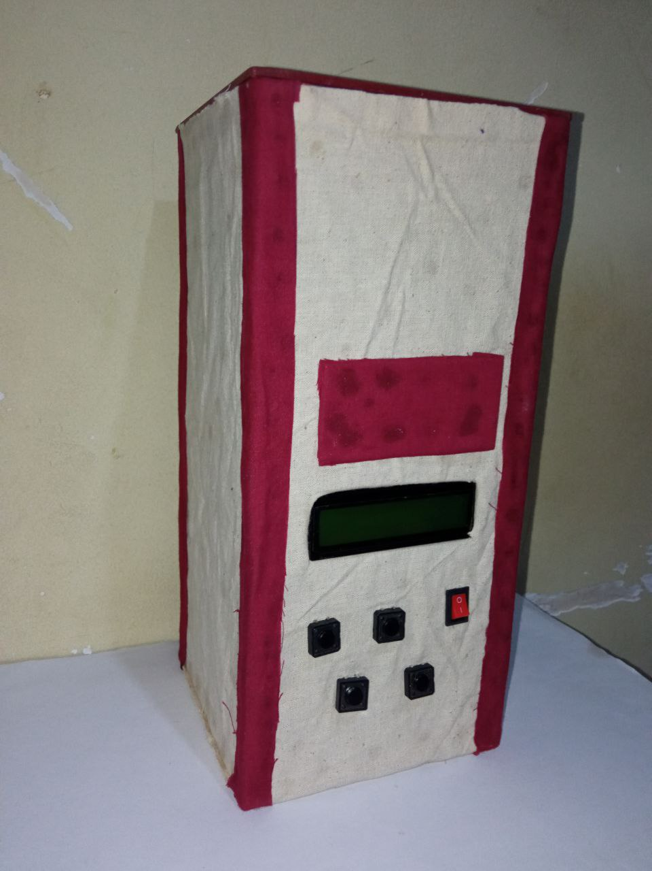
Our Innovative Product
We are proud to introduce our groundbreaking product,
the "MedSmart Medication Dispenser,"
designed to address one of the most pressing challenges in healthcare today.
Notes:
"Let's dive right in. MedSmart Innovations is a company committed to making a difference in healthcare. Our mission is to simplify medication management, ensuring that people get the right medicine at the right time."

Slide 3

The Medication Management Challenges
Managing medications can be complex, especially for seniors, individuals with chronic conditions, or those with memory impairments.
Medication non-adherence is a significant issue in healthcare, leading to adverse health outcomes, hospital readmissions, and increased healthcare costs.
Notes:
"Before we explore the solution, let's understand the problem. Medication errors are a real concern. Seniors often struggle with multiple medications, and caregivers face challenges in managing them. This can lead to health risks and increased hospitalizations."

Slide 4
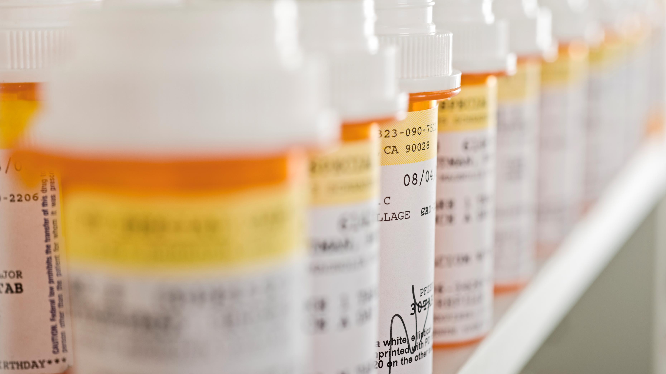





Our innovative solution simplifies medication management, ensuring patients receive the right medications at the right time.
Automated Medication Scheduling
Alarm Notifications
Medication Alerts
Safety Precautions
User-Friendly Design
Notes:
"MedSmart Innovations offers a solution – the MedSmart Medication Dispenser.“
"Let's take a closer look at some key features."

Slide 5
Our innovative solution simplifies medication management, ensuring patients receive the right medications at the right time.
Automated Medication Scheduling
Alarm Notifications
Medication Alerts
Safety Precautions
User-Friendly Design
Notes:
MedSmart simplifies medication scheduling, ensuring you're always on track with your prescriptions.
You can effortlessly set alarms for medication times, guaranteeing you never miss a dose.

Slide 6

Our innovative solution simplifies medication management, ensuring patients receive the right medications at the right time.
Automated Medication Scheduling
Alarm Notifications
Medication Alerts
Safety Precautions
User-Friendly Design
Notes:
Keeping up with your medication schedule is even more convenient with MedSmart.
The device doesn't stop at alarms; it sends text message reminders to your phone.

Slide 7

Our innovative solution simplifies medication management, ensuring patients receive the right medications at the right time.
Automated Medication Scheduling
Alarm Notifications
Medication Alerts
Safety Precautions
User-Friendly Design
Notes:
Plus, LED lights and a buzzer alert ensures you never overlook a dose.

Slide 8

Our innovative solution simplifies medication management, ensuring patients receive the right medications at the right time.
Automated Medication Scheduling
Alarm Notifications
Medication Alerts
Safety Precautions
User-Friendly Design
Notes:
"Safety is a top priority. MedSmart has built-in safety precautions to prevent accidental double doses."

Slide 9

Our innovative solution simplifies medication management, ensuring patients receive the right medications at the right time.
Automated Medication Scheduling
Alarm Notifications
Medication Alerts
Safety Precautions
User-Friendly Design
Notes:
our device boasts a user-friendly interface. Patients and caregivers can easily navigate its functions.“
Future Improvements"
"Looking ahead, we have plans for further improvements, including remote monitoring and control, refill alerts, and enhanced battery backup."

Slide 10
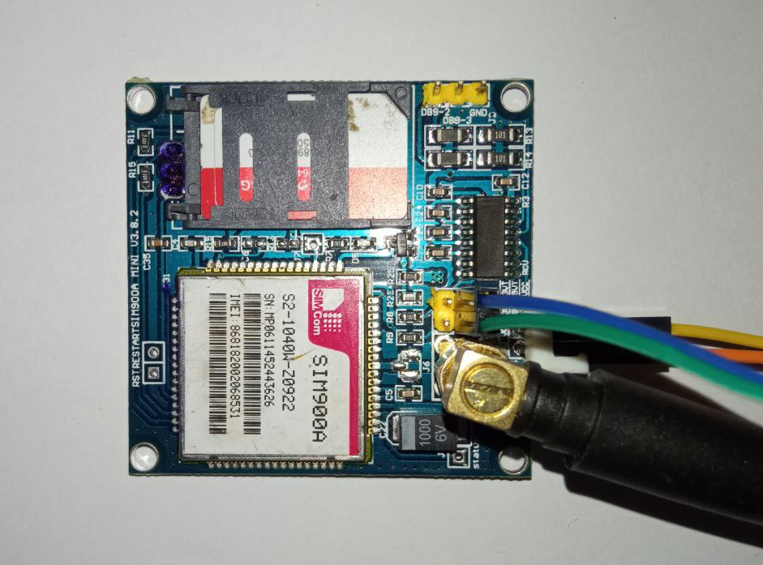
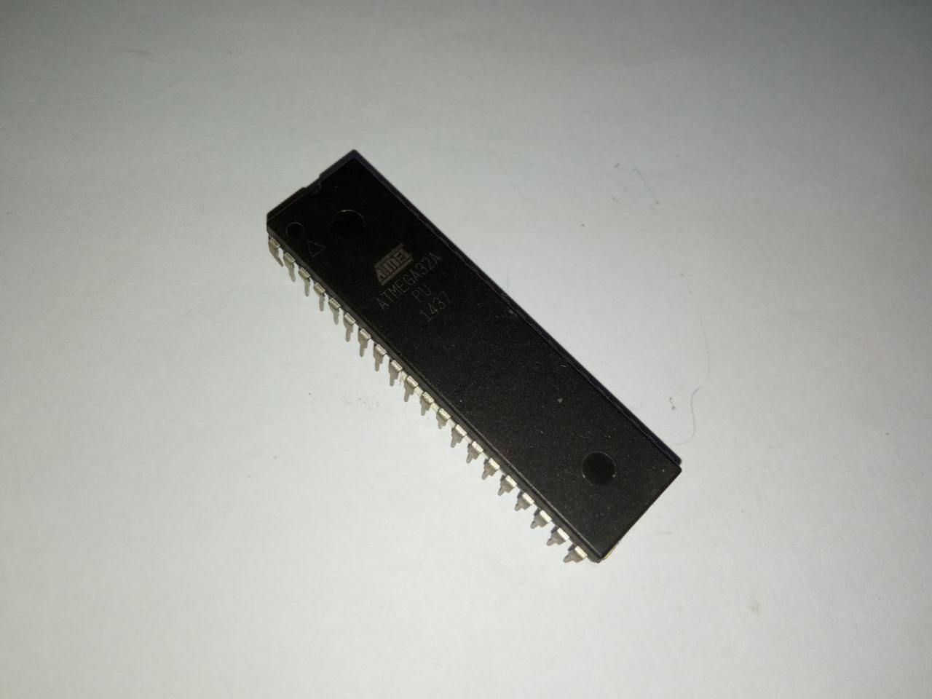
Hardware components
Notes:
our device boasts a user-friendly interface. Patients and caregivers can easily navigate its functions.“
Future Improvements"
"Looking ahead, we have plans for further improvements, including remote monitoring and control, refill alerts, and enhanced battery backup."

Slide 11
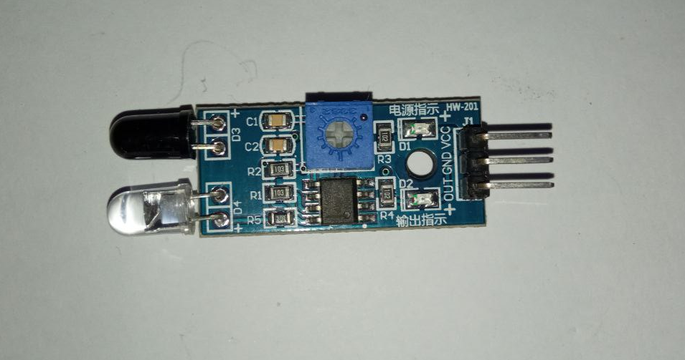
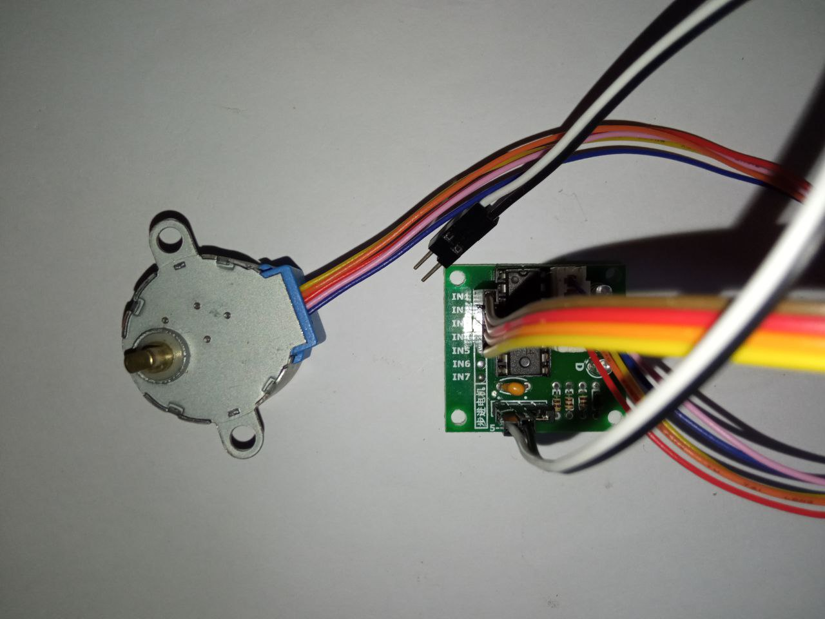
Hardware components
Notes:
our device boasts a user-friendly interface. Patients and caregivers can easily navigate its functions.“
Future Improvements"
"Looking ahead, we have plans for further improvements, including remote monitoring and control, refill alerts, and enhanced battery backup."

Slide 12
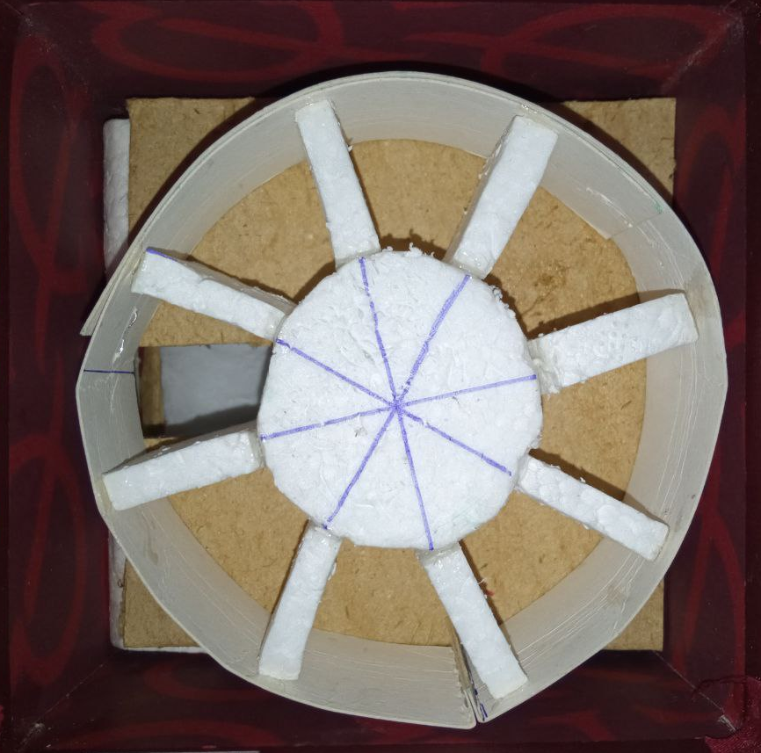
How to use MedSmart
Notes:
our device boasts a user-friendly interface. Patients and caregivers can easily navigate its functions.“
Future Improvements"
"Looking ahead, we have plans for further improvements, including remote monitoring and control, refill alerts, and enhanced battery backup."

Slide 13
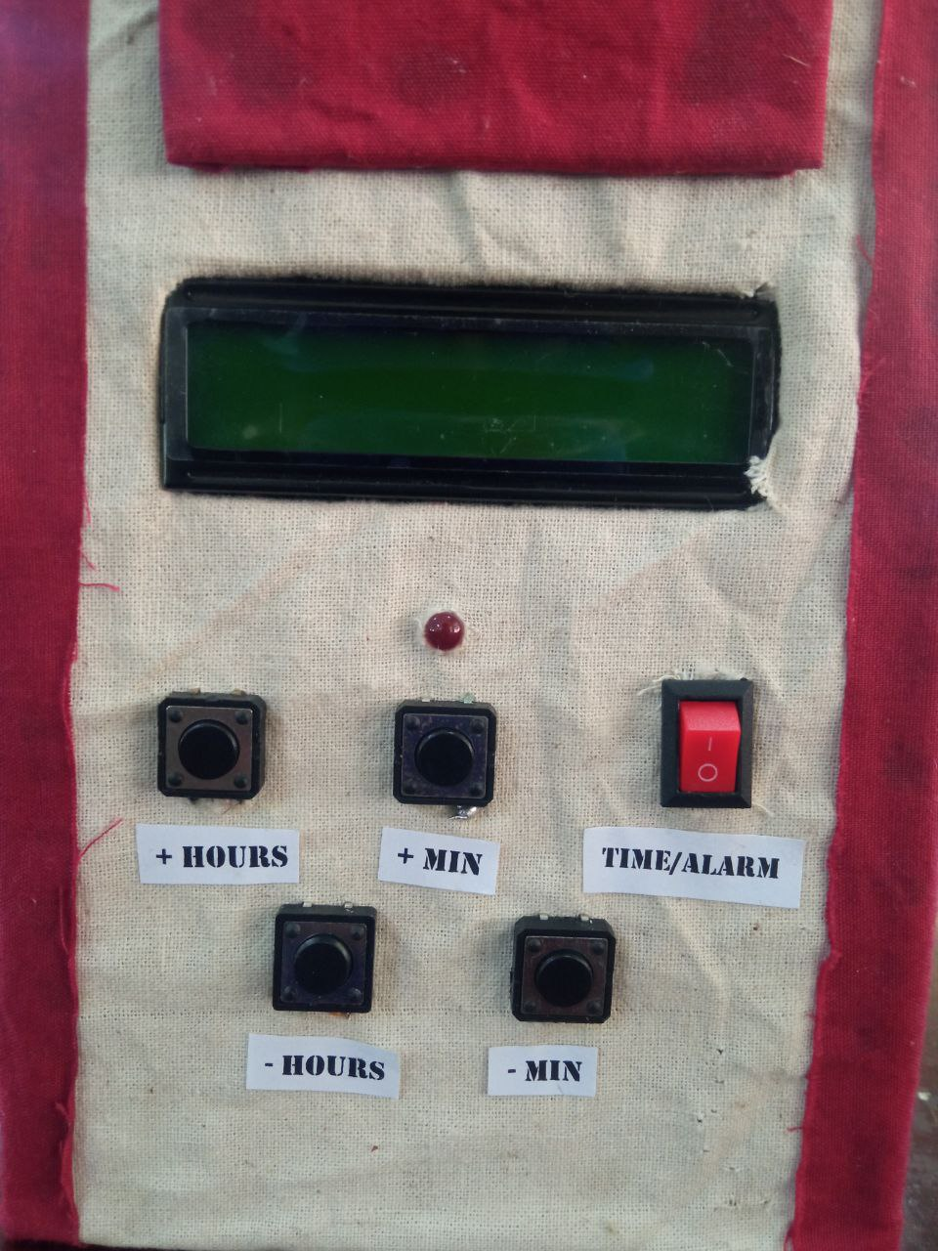
How to use MedSmart
Notes:
our device boasts a user-friendly interface. Patients and caregivers can easily navigate its functions.“
Future Improvements"
"Looking ahead, we have plans for further improvements, including remote monitoring and control, refill alerts, and enhanced battery backup."

Slide 14

Why Choose MedSmart?
User-Centric Design: Our device is easy to use, even for individuals with limited technical expertise.
Enhanced Medication Adherence: Reduce the risk of missed doses and improve patient health outcomes.
Refill Alerts: Get notified when it's time to refill medications.
Notes:
MedSmart isn't just a product; it's a lifeline. Here's why you should consider it.

Slide 15

The Medication Management Challenges
Managing medications can be complex, especially for seniors, individuals with chronic conditions, or those with memory impairments.
Medication non-adherence is a significant issue in healthcare, leading to adverse health outcomes, hospital readmissions, and increased healthcare costs.
Notes:
Before we dive into MedSmart's incredible features, let's acknowledge the medication management challenges millions face every day.
Forgetting a dose, taking the wrong medication, or struggling with complex schedules—these issues are more common than you might think.

Slide 16

Who Benefits from MedSmart?
Seniors: Enhance independence while managing medications.
Caregivers: Monitor and support loved ones' medication routines.
Individuals with Chronic Conditions: Ensure timely and consistent medication intake.
Healthcare Facilities: Improve medication management for patients.
Notes:
The big question: Who can benefit from MedSmart?
MedSmart is designed to serve a wide range of individuals. This includes seniors who want to live independently, caregivers looking for peace of mind, and anyone with complex medication needs.

Slide 17

Smart Medication Management
Medication Compartment: Eight separate windows for different doses.
User-Friendly Interface: LCD and push-button controls for easy setup.
Alarms and Notifications: Set custom alarms for medication reminders.
Refill Alerts: Receive timely notifications when it's time to restock.
Notes:
Now, let's talk about what makes MedSmart truly exceptional—smart medication management.
MedSmart is your personal medication assistant. It simplifies the entire process by automatically dispensing the right dose at the right time.
It doesn't just remind you to take your medication; it ensures you do.

Slide 18

MedSmart in Numbers
Dimensions: 26cm (height) x 12cm (width) x 318kg (weight).
Power Supply: Standard AC power with battery backup.
Material: Durable, lightweight, and safe for home use.
Capacity: Eight medication compartments.
Notes:
MedSmart consistently leads to higher medication adherence, fewer hospitalizations, and an overall improvement in health outcomes.
These aren't just numbers; they represent lives changed for the better.

Slide 19

Addressing a Growing Need
Aging Population: A significant demographic shift towards elderly individuals.
Chronic Conditions: Increasing cases of chronic diseases that require regular medication.
Caregiver Support: Aids caregivers in ensuring loved ones receive the right medication on time.
Notes:
Let's zoom out. We're not just addressing individual needs; we're meeting a growing demand.
As our population ages, the need for reliable medication management has never been greater. MedSmart aligns perfectly with this need.
We offer a proactive solution that's essential for the well-being of our seniors and anyone who depends on medication.

Slide 20

Thank You
P. V. Nipun Lakshitha
2020s18114
15367
Notes:
"We appreciate your time today. For further inquiries and partnerships, please feel free to reach out. Thank you."
"Here are our contact details for any inquiries or follow-up."
"With MedSmart Innovations, we're changing the landscape of healthcare, one smart medication dispenser at a time."

